Slide 1
MouseListener Interface on AWT

Slide 2
Types of Mouse Events
There are 8 types of Mouse events :
mouseClicked – user clicked the mouse
mouseDragged – user dragged the mouse
mouseEntered – Mouse entered a component
mouseExited – mouse exited from a component
mouseMoved – user moves the mouse
mousePressed – mouse was pressed
mouseReleased – mouse was released
mouseWheel – mouse wheel was moved

Slide 3
MouseListener Interface
The MouseListener needs 5 methods that need to be implemented
The general form of these methods are shown below :
Void mouseClicked(MouseEvent e)
Void mouseEntered(MouseEvent e)
Void mouseExited(MouseEvent e)
Void mousePressed(MouseEvent e)
Void mouseReleased(MouseEvent e)

Slide 4
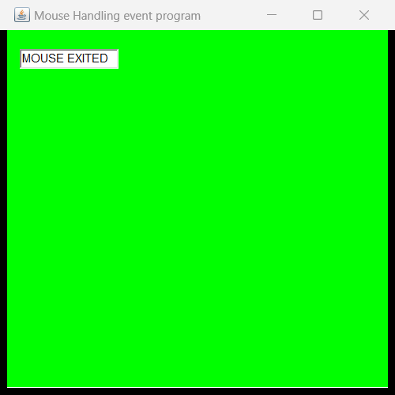
Desired output

